Slide 1


Slide 2

It is a collection of information arranged in a specific manner
  It consists of a set of tables
  Each table consists of a set of records
  Each record is classified into n-number of fields.
What is a database program?
  It allows a user to work with the information stored in the database.
  Some common capabilities: adding, removing, editing and searching for the information

Slide 3

  The database applications build with VB.NET are client-server applications
In an actual production environment, our application will be installed on many clients, and all of the clients will be accessing the same database, installed on the server.

Slide 4

ADO stands for ActiveX Data Objects: It is used by Microsoft as a means of accessing data from databases for many years and now ADO.NET is the latest version
ADO.NET is designed to create n-tier applicatons.
This means the program is divided into three, self-contained and largely independent units
  The data tier: actual database files
  The business tier: enforces business rules & processes
  The presentation tier : where user can view and interact

Slide 5

OR
Web Application
Business Rules
& Processes
Local
or Remote File Store
Windows Form Application
This arrangement provides abstraction and thus changes can be applied to one layer without affecting the other layers
Example: adding a new rule

Slide 6

It is a disconnected architecture.
  This means an open-connection is not maintained between the tiers continuously for duration of the session
  Maintaining otherwise will degrade performance especially when there are multiple users accessing the same resource
  Note**
    We can maintain continuous connection if its desirable, but not the default model of ADO.NET

Slide 7

Steps:
  It connects to the data source and
  Retrieves the required information then
  Closes the connection.
DataSet object:
  represents the extracted data. It provided an in-memory cache that client application can work with
  Any changes to this data is then written back to the data source
  Thus, the client program is working with a local DataSet object and not the data source

Slide 8

.NET DataProvider
DataSet
Connection
DataAdapter
DataTable Collection
Transaction
DataTable
Select
DataRow Collection
Command
Insert
DataColumn Collection
Transaction
Update
Constraint Collection
DataReader
Delete
DataRelation Collection
DataBase
XML

Slide 9

ADO.NET uses XML to pass data between the server and the client.
Fortunately, you don’t have to write any XML code yourself to retrieve the information.
ADO.NET uses XML for its own purposes.

Slide 10

Data Access in ADO.NET relies on two components:
  DataSet and,
  DataProvider

Slide 11

It is responsible for providing and maintaining the connection to the database.
It is a set of related components that work together to provide data in an efficient and performance driven manner.
The .NET Framework currently comes with two DataProviders:
  SQL DataProvider which is designed only to work with Microsoft's SQL Server 7.0 or later and
  OleDb DataProvider which allows us to connect to other types of databases like Access and Oracle.

Slide 12

Each DataProvider consists of the following component classes:
  Connection object: provides a connection to the database
  Command object: use for executing a command
  DataReader object:
    provides a forward-only, read only connected recordset
  DataAdapter object:
    populates a disconnected DataSet with data and performs update.

Slide 13

A connection object establishes the connection for the application with the database.
The command object provides direct execution of the command to the database.
If the command returns more than a single value, the command object returns a DataReader to provide the data.
Alternatively, the DataAdapter can be used to fill the Dataset object.
Note**: The database can be updated using the Command Object or DataAdapter.

Slide 14

Sometimes, we want to retrieve data from the database and read them sequentially. If we do not plan to edit the data and submit any changes back to the client, we can use the DataReader object to read the rows sequentially.
The DataReader is an object that lets one iterate through the rows retrieved by a query. It is faster than retrieving all the rows to a DataSet, but one cannot move back and forth in the rows. Hence, it returns a forward-only, read-only result.
Moreover, the connection to the database is open while you iterate through the rows, so the processing should be as quick as possible.

Slide 15

To get the data into a Dataset, we must first establish a connection to the database. The Connection object allows us to specify the database we want to work with.
Between the database and the Dataset there is another object, the DataAdapter object. The communication between the database and the Dataset takes place through the DataAdapter.
The DataAdapter object knows how to update the database as well as how to move data from the database and store them into the DataSet.

Slide 16
The DataAdapter object contains four commands
  SELECT - for retrieving rows from the database
  UPDATE - updating existing rows
  DELETE - deleting existing rows
  INSERT - inserting new rows.
These commands are SQL statements used to move data between the DataSet and the underlying data source.

Slide 17

All the classes which are required for working with a database outside VB.NET are all part of the namespace called System.Data.OleDb
Thus for any database application, we need to first import this namespace by writing
Imports System.Data.OleDb
as the first line of code

Slide 18

The Connection Object is what you need if you want to connect to a database.
There are a number of different connection objects, and the one you use depends largely on the type of database you're connecting to.
Because we're connecting to an Access database, we'll need something called the OleDbConnection object.
OLE stands for Object Linking and Embedding, and its basically a lot of objects (COM objects) bundled together that allow you to connect to data sources in general, and not just databases.
There are a number of different OLE DB objects (called data providers), but the one we'll use is called "Jet". Others are SQL Server and Oracle.

Slide 19

To create a connection, we need to add the following line:
Dim conn As New OleDbConnection
There are many properties and methods associated with the Connection Object. Fortunately, we only need a few of these.
We need to pass two things to our new Connection Object:
  The technology we want to use to do the connecting to our database called Provider
  location of the database is called Data Source
To do so, we need to add this to our code:
conn.ConnectionString = "PROVIDER = Microsoft.Jet.OLEDB. 4.0;
Data Source = <databasename>.mdb"
When no path is provided in Data Source then it means the database is stored in the bin/Debug folder of the application

Slide 20

Now that we have a ConnectionString, we can go ahead and open the database.
This is quite easy - just use the Open method of the Connection Object:
conn.Open( )
Once open, the connection has to be closed again. This time, just use the Close method:
conn.Close( )

Slide 21

Command objects execute SQL batch statements or stored procedures over an open Connection.
To create a command, we need to add the following line of code:
Public cmd As New OleDbCommand
The Command Object has a property called CommandText, which contains a String value that represents the command that will be executed in the Data Source. This property is used, as shown below:
cmd.CommandText = "Select * from Student”
To execute the SQL statement against a Data Source, you have to create a Connection Object and open a connection to the Data Source, and assign the open connection to the connection property of the Command Object. To do so, we need to use the Connection property of the Command object, as shown below:
cmd.Connection = conn

Slide 22
Structure Of A DataSet Object
DataSet
Tables
DataTable
Rows
DataRow
Columns
DataColumn
Constraints
In this diagram, ovals are collections and rectangles are objects
Relations
Constraint
DataRelation

Slide 23

A DataSet object provides an in memory cache, or copy, of data that has been extracted from a data source.
Tables Property of the DataSet
  The tables in the DataSet are contained in a collection that you access by the Tables property.
  We can use the Tables.Count property to determine how many tables in the DataSet contains.
  Then, use the Tables.Item(“tablename”) method to obtain a reference to a specific table:

Slide 24

Each table in a DataSet is represented by a DataTable object.
Example:
Dim ds as New DataSet
Dim dt As DataTable
dt = ds.Tables.Item(“Student”)
Each table consists of rows and columns.
For a given table, these are accessed by means of the Columns and Rows collections.
The Columns property returns a type DataColumnCollection, which in turn contains one type DataColumn for each column in the table.
The Rows property returns a type DataRowCollection, which in turn contains one type DataRow for each row in the table.

Slide 25

0 | 1 | 2 | 3 | 4 | 5 | ……. | Columns.Count-1
0
1
2
3
4
5
…….
Rows.Count-1

Slide 26
The DataSet object exposes members for accessing its contents. The tables in a DataSet are exposed through the Tables collection, which is made up of DataTable objects.
If the tables are related, the relations are exposed by the Relations collection, which is made up of DataRelation objects.
The DataTable object’s most important property is the Rows property, which is a collection of DataRow objects. The DataRow object, in turn, exposes the Item property, which is a value of a specific column (field) in a row.
Example: Here dt is a DataTable
i) dt.Rows(<row_no.>).Item(“column_name”)‏,or
ii) dt.Columns(<column_no.>).<column_name>

Slide 27

The row begins with number 0 to n-1, where n is the total number of rows
To go to a particular column of a particular row,
dt.Rows(row_number).Item(“Column_name”)
Locating a row
Locating a particular column

Slide 28

An individual piece of data in a table belongs to a specific row (record) and a specific field (column).
To get at the data, therefore, we must identify its row and column.
This is done by first getting a reference to the row, and then specifying the column.
We use the DataRow object’s Item( ) property for this.
Syntax
Dim dr As DataRow
<variable>=dr.Item(“column_name”)
<variable>=dr.Item(column_position)
‘begins from 0 to m-1, where m is the number of columns in
the row

Slide 29

To delete an entire row from a table, obtain a reference to the row and then call the Delete() method.
First, we have to go to that particular row & then delete
Syntax:
Dim dr As DataRow
dr.Delete()
Example
Dim sid As Integer =1
For each dr In dt.Rows
If dr.Item(“StudentId”) = sid Then
dr.Delete( )
Exit For
End If
Next

Slide 30

To create a new row that has the same schema (fields) as an existing table, call the table's NewRow( ) method.
NewRow( ) - This method creates a new row with the same fields as the other table rows, and returns a reference to it.
Steps for adding a new row to a table:
  We create a new empty row of the particular table. It is not yet part of any table but exists independently.
  Add data to this row, i.e. fill up the columns of the row with data
  Add this new row to the table, by using the Rows collection’s Add( ) method

Slide 31

If dt is a reference to the table, here is the syntax:
Example:
Dim dt As dataTable
Dim dr As DataRow
dt = ds.Tables(“Student”)
dr = dt.NewRow()
dr.Item(“StudentId”) = Cint(txtId.Text)
dr.Item(“StudentName”) = txtName.Text
dr.Item(“RollNo”) = CInt(txtRoll.Text)
dt.Rows.Add(dr)
New Empty Row Created
Adding data to Columns
Adding New Row To Table

Slide 32

When we made changes to a table – changing existing data, deleting rows, or adding rows – the changes are temporary until we take steps to make them permanent.
The following slide shows the methods

Slide 33

Method | Description
AcceptChanges( ) | Commits all changes made to the table since it was created or since the last time AcceptChanges( ) was called.
GetChanges( ) | Gets a copy of the table containing all changes that were made since it was created or since the last time AcceptChanges( ) was called.
RejectChanges( ) | Rejects all changes made to the table since it was created or since the last time AcceptChanges( ) was called.

Slide 34

Remember that a DataSet is an in-memory copy of data that originated in a data source, and was copied from the data source to the DataSet by a data adapter.
To copy changes from your DataSet back to the data source – to persist the changes – we call the data adapter’s Update( ) method.
This must be done before we either accept or reject the DataSet changes as described in the previous slide.

Slide 35

In order for the Update( ) method to work properly, the data adapter must be provided with the appropriate SQL update command. This can be done manually, but it is a lot easier to use a command builder that we associate with the data adapter.
There are two types of command builders: SQLCommandBuilder, for use with SQLDataAdapter, and OleDbCommandBuilder, for use with OleDBDataAdapter.
By creating a command builder and associating it with our data adapter, we enable the required SQL command to be generated automatically.

Slide 36

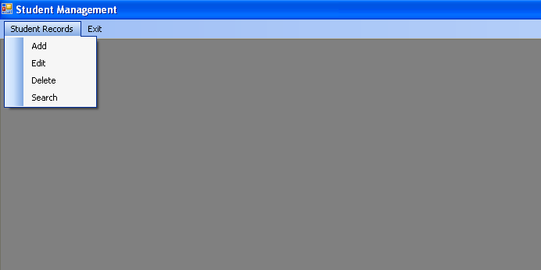

Slide 37

In the main form, provide the code for the menu items to call the other forms or child forms and exiting the application
We will declare all the OLEDB objects and make them Public in nature (atleast dataset should be public)
We will use the form load event of this form to connect to the database as it is the startup form of our application
Also we will have a subroutine which is Public and called UpdateTable() to make the changes in the dataset permanent and also update the data source

Slide 38

Imports System.Data.OleDb
Module Module1
Public conn As New OleDbConnection()
Public cmd As New OleDbCommand
Public da As New OleDbDataAdapter()
Public ds As New DataSet("My Student")
Sub connect()
conn.ConnectionString = "Provider = Microsoft.Jet.OLEDB.4.0;
Data Source = student.mdb"
conn.Open()
cmd.CommandText = "Select * from Student"
cmd.Connection = conn
da.SelectCommand = cmd
da.Fill(ds, "Student")
End Sub
End Module

Slide 39

Public Sub update(ByVal dt As DataTable)
Dim comBld As New OleDbCommandBuilder(da)
Dim ndt As DataTable
ndt = dt.GetChanges()
dt.AcceptChanges()
da.Update(ndt)
End Sub
End Module

Slide 40

Imports System.Data.OleDb
Public Class FrmMain
Sub Form_Load()
Module1.connect()
End Sub
End Class

Slide 41

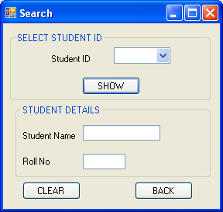

Slide 42

Public Class FrmSeach
Dim dt As DataTable
Dim dr As DataRow
Private Sub Form5_Load(… …) Handles MyBase.Load
dt =FrmMain.ds.Tables.Item("Student")
For Each Me.dr In dt.Rows
ComboBox1.Items.Add(dr.Item("StudentId"))
Next
End Sub
Private Sub btnBack_Click(… …) Handles Button2.Click
txtName.Clear()
txtRoll.Clear()
FrmMain.Show()
Me.Close()
End Sub

Slide 43
Private Sub btnOK_Click(... ...) Handles Button1.Click
Dim sid As Integer
For Each Me.dr In dt.Rows
sid= CInt(ComboBox1.SelectedItem)
If dr.Item("StudentId")=sid Then
txtName.Text = dr.Item("StudentName")
txtRollNo.Text = dr.Item(“RollNo")
End If
Next
End Sub
End Class

Slide 44

Imports System.Data.OleDb
Public Class FrmSearch
Dim sid As Integer
Dim name As String
Dim rollno As Integer
Dim dt As DataTable
Dim dr As DataRow
Private Sub Form2_Load(…) Handles MyBase.Load
Dim n As Integer
dt = FrmMain.ds.Tables.Item("Student")
For Each Me.dr In dt.Rows
n = dr.Item("StudentId")
Next
txtid.Text = n+1
End Sub
Private Sub btnBack_Click(…) Handles Button2.Click
FrmMain.Show()
Me.Close()
End Sub
To get the next valid student Id

Slide 45

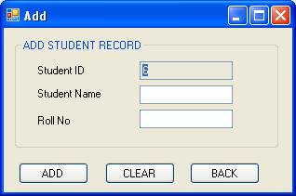
ReadOnly=True

Slide 46

Private Sub btnAdd_Click(…) Handles
Button1.Click
sid = CInt(txtId.Text)
name = txtName.Text
rollno = CInt(txtRollNo.Text)
dt = Module1.ds.Tables.Item("Student")
dr = dt.NewRow()
dr.Item("StudentId") = sid
dr.Item("StudentName") = name
dr.Item(“RollNo") = rollno
dt.Rows.Add(dr)
txtId.Clear()
txtName.Clear()
txtRoll.Clear()
btnAdd.Enabled = False
FrmMain.updateTable(dt)
End Sub
End Class

Slide 47

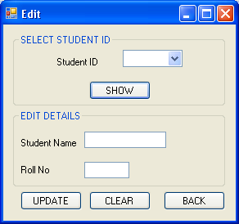

Slide 48

Imports System.Data.OleDb
Public Class FrmEdit
Dim dt As DataTable
Dim dr As DataRow
Private Sub Form3_Load(…) Handles MyBase.Load
Dim sid as Integer
dt = FrmMain.ds.Tables.Item("Student")
For Each Me.dr In dt.Rows
sid=dr.Item(“StudentId”)
ComboBox1.Items.Add(sid)
Next
End Sub
Private Sub btnOk_Click(…) Handles Button3.Click
Dim sid As Integer
For Each dr In dt.Rows
sid= CInt(ComboBox1.SelectedItem)
If dr.Item("StudentId") = sid Then txtName.Text=dr.Item("StudentName")
txtRollNoText = dr.Item(“RollNo")
End If
Next
End Sub

Slide 49
Editing a record (2/2)
Private Sub btnEdit_Click(…) Handles Button1.Click
Dim selectedId As Integer
Dim ans As Integer
selecedId = cmbId.SelectedItem
ans = MsgBox("Do you want to save changes to this record?", MsgBoxStyle.YesNo, "Message Info")
dt =ds.Tables ("Student")
If ans = vbYes Then
For i=0 to rows-1
dr=dt.Rows(i)
if selectedId=dr.Item(0) then
dr.Item("Student_Name") = txtName.Text
dr.item(“RollNo") = CInt(txtRollNo.Text)
Module1.update(dt)
MsgBox("Changes saved")
End If
Next
End If
txtName.Clear()
txtRollNo.Clear()
btnEdit.Enabled = False
End Sub
Private Sub btnBack_Click(…) Handles Button2.Click
FrmMain.Show()
Me.Close()
End Sub
End Class

Slide 50
Deleting a record
Private Sub btnDelete_Click(…) Handles Button1.Click
Dim selectedId As Integer
Dim ans As Integer
selecedId = cmbId.SelectedItem
ans = MsgBox("Do you want to delete this record?", MsgBoxStyle.YesNo, "Message Info")
dt =ds.Tables ("Student")
If ans = vbYes Then
For i=0 to rows-1
dr=dt.Rows(i)
if selectedId=dr.Item(0) then
dr.Delete()
Module1.update(dt)
Exit For
MsgBox("Changes saved")
End If
Next
End If
txtName.Clear()
txtRollNo.Clear()
btnDelete.Enabled = False
End Sub
Private Sub btnBack_Click(…) Handles Button2.Click
FrmMain.Show()
Me.Close()
End Sub
End Class

Slide 51

Here, the user selects an ID from the ComboBox and on the click of the button that selected record is displayed in DataGridView control
Private Sub btnLoadSelected_Click(ByVal sender As System.Object, ByVal e As System.EventArgs) Handles btnLoadSelected.Click
Dim selectedId As Integer
selectedId = cmbId.SelectedItem
Dim found() As DataRow
found = dt.Select("student_id = " & selectedId)
Dim dfound As DataTable = found.CopyToDataTable
DataGridView1.DataSource = dfound
End Sub

Slide 52
We use the Select() Function which returns a set of rows which match the specified condition.
It accepts arguments which are as follows:
  Select(filter expression, [“column-name for sorting the rows”])
It returns a set of rows in the form of an array of DataRow
Example:
  Dim dt As Datatable, drArr() as DataRow
  dt=ds.Tables(“student”)
  drArr=dt.Select(“student_id<= ” & 10, “student_name”)
  Datagridview1.DataSource=drArr.CopyToDataTable
Result: This generates the list of students whose ID <= 10 and are sorted based on the name column

Slide 53
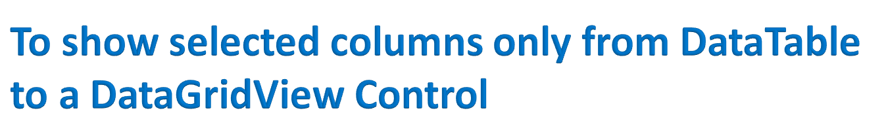
Private Sub btnLoadSelected_Click(ByVal sender As System.Object, ByVal e As System.EventArgs) Handles btnLoadSelected.Click
DataGridView1.DataSource = ds.Tables(“student”)
DataGridView1.Column(2).Visible=False
End Sub
‘The Student table has only 3 columns of indices 0,1, and 2
‘ In the above code, we are omitting the last column

